Slide 1
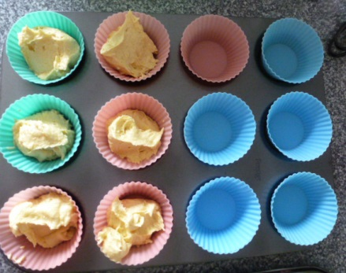
Equivalent Fractions
What fraction of the bun cases are full ?
Think of some different ways to write
the same fraction.
Notes:
6/12 or ½ or 2/4 or 3/6 show by drawing lines on photos to partition the 12 objects.

Slide 2
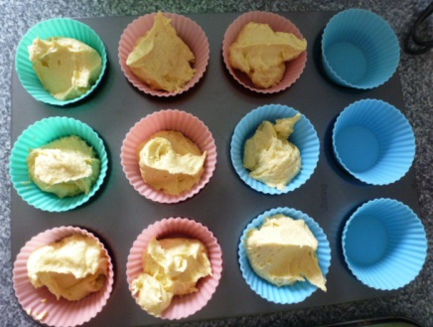
What fraction of the bun cases are full now ?
Write the fraction in different ways.
What fraction of the bun cases are empty ?
Notes:
9/12 or ¾ show by drawing lines on the photos to partition the 12 objects in different ways. Emphasise that the two fractions are EQUIVALENT, they represent the same share of the whole tray.

Slide 3
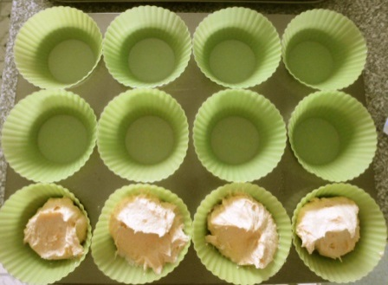
What fraction of the bun cases are full ?
Can you find different ways to write the fraction ?
What fraction of the bun cases are empty ?
Notes:
4/12 1/3 2/6

Slide 4
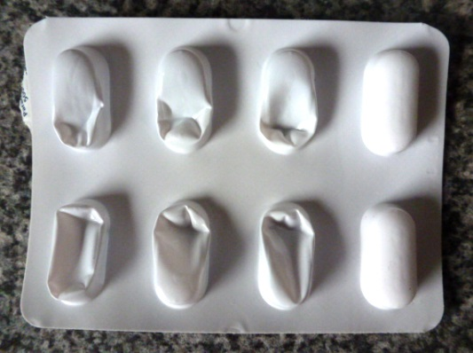
What fraction of the pills have been used ?
Write two equivalent fractions.
What fraction of the pills are left ?
Notes:
2/8 1/4

Slide 5
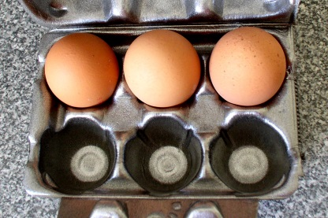
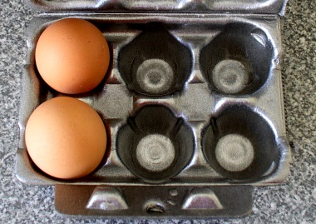
What fraction of the eggs are left in each box ?
Write the fraction in different ways.
Notes:
3/6 = ½ and 2/6 = 1/3

Slide 6
3
5
3
5
Shade
Shade
What fraction of each shape is unshaded ?
Notes:
If necessary draw horizontal lines on the second box to emphasise the fifths. Shade the SAME section of each box. Get students to see the equivalent fraction 6/10

Slide 7
2
3
2
3
Shade
Shade
What fraction of each shape is unshaded ?
Notes:
If necessary draw vertical lines on the second box to emphasise the thirds. The equivalent fraction is 6/9

Slide 8
3
4
3
4
Shade
Shade
What fraction of each shape is unshaded ?
Notes:
The equivalent fraction is 6/8

Slide 9
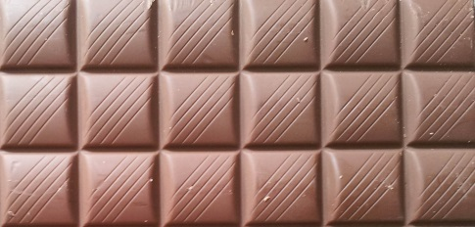
This bar of chocolate is made up of eighteen squares.
Show how to split the bar up to show these equivalent fractions.
=
Fill in the
missing number.
1
2
18
1
3
=
18
1
6
=
18
Notes:
Use the space to fill in equivalent forms for 2/3 and 5/6 etc.

Slide 10
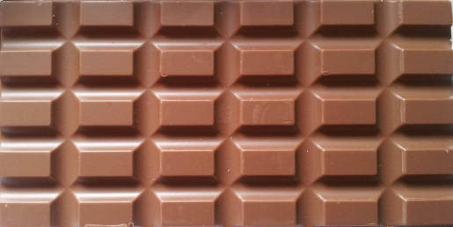
This bar of chocolate is made up of thirty pieces.
Show how to split the bar up to show these equivalent fractions.
=
Fill in the
missing number.
1
2
30
1
3
=
30
1
5
=
30
Notes:
Use the space to fill in equivalent forms for 2/3 and 4/5 etc.

